Slide 1

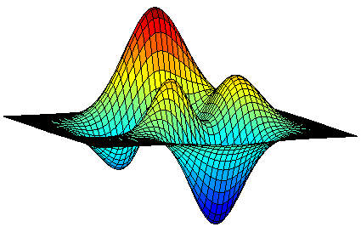
Streaming Algorithms for Cardinality Constrained Submodular Maximization
Moran Feldman
University of Haifa
Based on
The One-way Communication Complexity of Submodular Maximization with Applications to Streaming and Robustness.
Feldman, Norouzi-Fard, Svensson and Zenklusen. STOC 2020.
Optimal Streaming Algorithms for Submodular Maximization with Cardinality Constraints.
Alaluf, Ene, Feldman, Nguyen and Suh. ICALP 2020.

Slide 2


Submodular Maximization: What and Why
Set functions are functions that assign values to sets.
Submodular functions are set functions that have the natural property of diminishing returns.
Formal definitions later.
Many Applications
Combinatorics
cut functions
coverage
matroid rank fuctions
Economics
Buying 100 apples is cheaper than buying them separately.

Slide 3

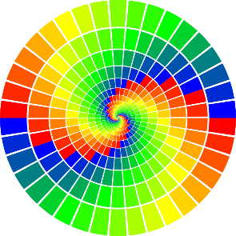
Brief History of Submodular Max.
1970s
First results for submodular maximization.
Combinatorial algorithms: greedy and local search.
Around 2010
Introduction of continuous tools (multilinear extension, symmetry gap).
A new wave of theoretical results.
Σ
A few years later
Since submodularity captures summarization, increasing interest in the ML community.

Slide 4

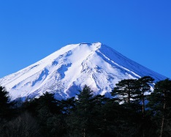


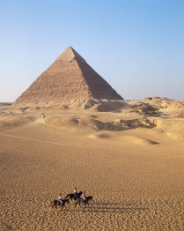



Standard Summarization Tasks
Σ
Photo Album Summarization
Objective: Select a summary of k photos.
Diminishing Returns:
One picture of a mountain is essential.
A second picture of a mountain is nice.
A third picture of a mountain is useless.

Slide 5


Standard Summarization Tasks (cont.)
Σ
Document Summarization
Select k sentences out a document that summarize its content.
Movie Recommendation
Select k movies that summarize the set of good movies (good for the particular user).

Slide 6
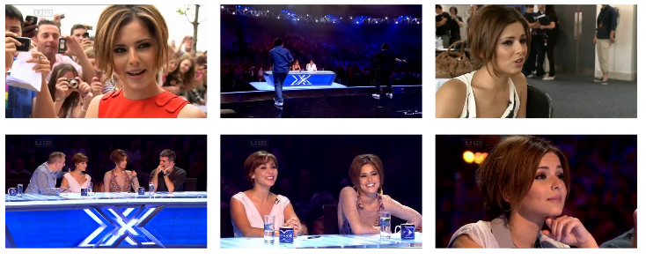
Standard Summarization Tasks (cont.)
Σ
Video Summarization
Select k frames out of a video that summarize it the best.
Main focus of this talk
Streaming
Video is often long (think about a surveillance camera).
We should process on the fly.
Parallelization
Multiple function evaluations in parallel (adaptive complexity)
Map-Reduce
Other big data cases motivate:
Motivates:

Slide 7



Formal Setting – Offline Problem
Given a ground set N, a set function f : 2^{N} → R assigns a number to every subset of the ground set.
A set function is submodular if:
  f(A + u) – f(A) ≥ f(B + u) – f(B) ∀ A ⊆ B ⊆ N, u ∉ B.
Objective function
5
4
3
7
11
0
N
6
8
11
5
10

Slide 8
Formal Setting – Offline Problem
Given a ground set N, a set function f : 2^{N} → R assigns a number to every subset of the ground set.
A set function is monotone if:
  f(A) ≤ f(B) ∀ A ⊆ B ⊆ N
Objective function
Sometimes we also assume monotonicity.
7
11
Problem of Interest
Input:
a non-negative submodular function f : 2^{N} → R.
a positive integer k.
Objective: output a set S ⊆ N of size at most k maximizing f.
0
6
8
11
5
10

Slide 9

Example 1: Set Cover
Elements E = {e₁, e₂, …, e_{n}} and sets s₁, s₂, …, s_{m} ⊆ E.
Formally, for every S = {s_{i1}, s_{i2}, …, s_{ik}} the objective is
Observation: f(S) is a non-negative monotone submodular function.
Elements E = {e₁, e₂, …, e_{n}} and sets s₁, s₂, …, s_{m} ⊆ E.
Problem: find k sets that cover together as many elements as possible.
Standard “monotone” problem.
Good to keep in mind as intuition.
s₂
s₃
s₁
s₄
s₅

Slide 10

Example 2: Unbalanced Cut
A directed graph G = (V, E) with capacities c_{e} ≥ 0 on the arcs.
Problem: find a set S of size at most k defining a maximum capacity cut.
Formally, For every S ⊆ V:
Observation: f(S) is a non-negative submodular function.
f(S) = 3

Slide 11

Offline State-of-the-Art
Monotone Problem
(1 – 1/e)-approximation via the greedy algorithm [NWF78].
Matching information theoretic inapproximability. [NW78]
Non-monotone Problem
0.385-approximation via a combination of the continuous greedy algorithm and continuous local search [BF19].
Information theoretic inapproximability of 0.491 [V13]
Remaining gap: one of the most important problems in the field.
Other Constraints Considered
Examples: matroid, knapsack, matching, p-set system…
Many of them studied also in the streaming setting.

Slide 12
Formal Setting – Streaming Problem
The elements of the ground set are read one by one by the algorithm.
After reading all the elements, the algorithm should produce the output set.
Output subset of the input
A streaming algorithm keeps O(Polylog(n)) memory.
Infeasible when the solution (and not just its value) should be outputted.
For simplicity, we present the hardness results with the same assumption.
Algorithm
A semi-streaming algorithm is an algorithm that keeps O(k ⋅ Polylog(n)) memory.
Existing algorithms also keep O(k ⋅ Polylog(n)) elements (no encoding).

Slide 13

Results
The short answer: 1/2
(1/2 - ε)-approximation algorithm for monotone functions [BMKK14]
(1/2 + ε)-approximation hardness for monotone functions
Uses exponential time.
3.6-approximation in polynomial time.
(1/2 - ε)-approximation algorithm for general functions
(1/2 + ε)-approximation hardness for general functions

Slide 14

Tool: Knowing the value of OPT
More correctly τ is an ε-estimate of f(OPT), but we ignore that.
We may assume access to the value τ of OPT
Approach
Maintaining dynamic upper and lower bounds on the value of OPT.
Running the algorithm in parallel for an exponential list of candidate τ ’s within the range defined by these bounds.
Bounds
The lower bound is the best singleton.
The upper bound is k times the best singleton.
Upper bound
candidate τ’s
Lower bound

Slide 15

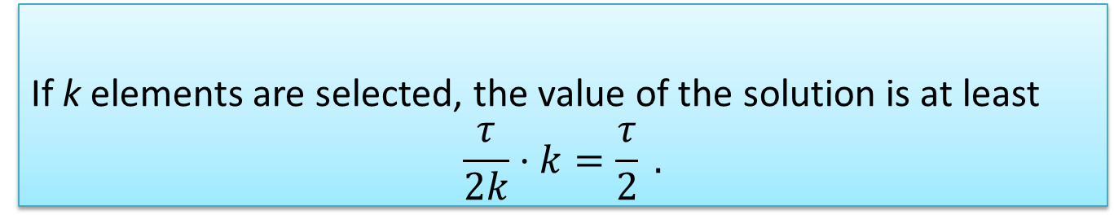
Algorithm for Monotone Functions
As long as we have less than k elements, select every element whose marginal value is at least τ / (2k).
Algorithm
If k elements are selected, the value of the solution is at least
$$\frac{τ}{2k}⋅k=\frac{τ}{2} .$$
Analysis – Part 1
Analysis – Part 2
If less than k elements are selected, no element of OPT / S contributes τ / (2k) ⎯ S is the solution of the algorithm here.
$$f\left(S\right)≥f\left(S ∪OPT\right)−\sum_{u∈OPT\backslash S}{\left[f\left(S+u\right)−f\left(S\right)\right]}$$
$$≥τ−k⋅\frac{τ}{2k}=\frac{τ}{2} .$$
Space Complexity
The algorithms stores a single solution, so it requires O(k) space.
Assuming access to τ requires parallel repetitions, increasing the space complexity to O(ε⁻¹k log k).
Improving the lower bound on OPT using the current solutions improves the space complexity to O(ε⁻¹k) [KMZLK19]

Slide 16
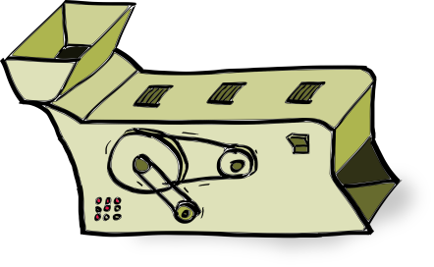
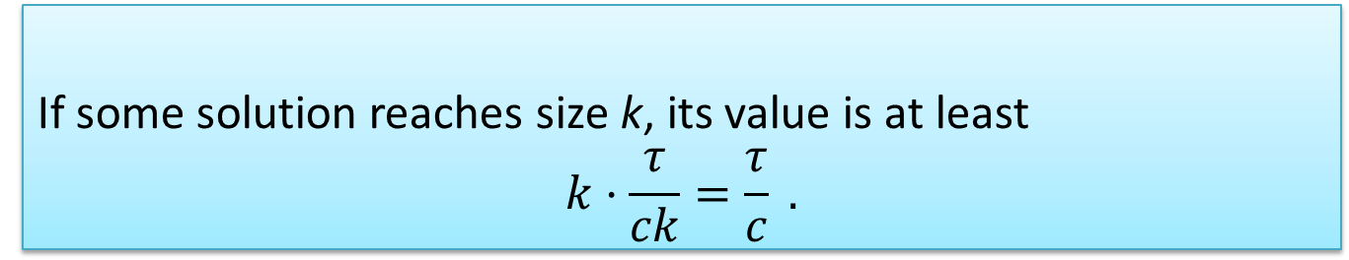
Algorithm for General Functions
Maintain m = ε ⁻¹ solutions S₁, S₂, …, S_{m}.
For every element u arriving, add u to some solution if this increases the value of the solution by at least τ / (ck).
Output the best subset of S₁ ∪ S₂ ∪ ⋅⋅ ∪ S_{m} .
Algorithm
If some solution reaches size k, its value is at least
$$k⋅\frac{τ}{ck}=\frac{τ}{c} .$$
Analysis – Part 1
Handling the case of no solution of size k is more difficult…
Analysis – Part 2

Slide 17

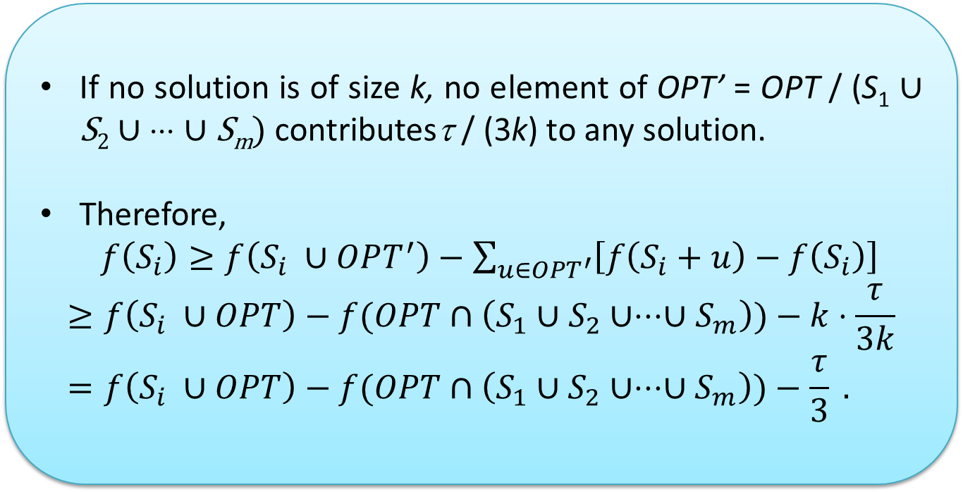
Simple 1/3-Approximation
Set c = 3 so that Part 1 works.
If no solution is of size k, no element of OPT’ = OPT / (S₁ ∪ S₂ ∪ ⋅⋅⋅ ∪ S_{m}) contributesτ / (3k) to any solution.
Therefore,
  $f\left(S_{i}\right)≥f\left(S_{i} ∪OPT^{′}\right)−\sum_{u∈OPT^{′}}{\left[f\left(S_{i}+u\right)−f\left(S_{i}\right)\right]}$
$$≥f\left(S_{i} ∪OPT\right)−f(OPT∩\left(S_{1}∪S_{2}∪⋅⋅⋅∪S_{m}\right))−k⋅\frac{τ}{3k}=f\left(S_{i} ∪OPT\right)−f(OPT∩\left(S_{1}∪S_{2}∪⋅⋅⋅∪S_{m}\right))−\frac{τ}{3} .$$

Slide 18
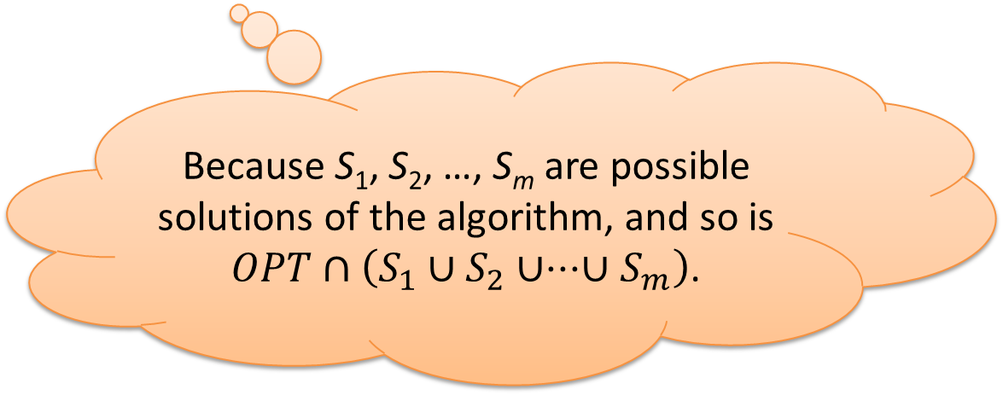
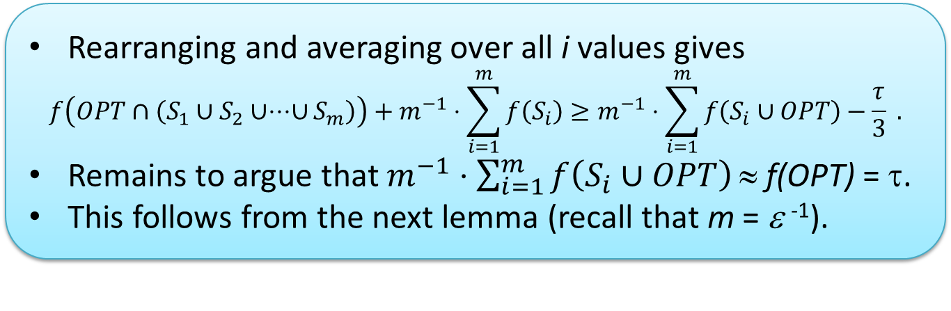
Simple 1/3-Approximation (cont.)
Rearranging and averaging over all i values gives
$$f\left(OPT∩\left(S_{1}∪S_{2}∪⋅⋅⋅∪S_{m}\right)\right)+m^{−1}⋅\sum_{i=1}^{m}{f\left(S_{i}\right)}≥m^{−1}⋅\sum_{i=1}^{m}{f\left(S_{i}∪OPT\right)}−\frac{τ}{3} .$$
Remains to argue that $m^{−1}⋅\sum_{i=1}^{m}{f\left(S_{i}∪OPT\right)}\text{≈ }\text{f}\text{(}\text{OPT}\text{) }\text{=} $.
This follows from the next lemma (recall that m = ε ⁻¹).
Because S₁, S₂, …, S_{m} are possible solutions of the algorithm, and so is $OPT∩\left(S_{1}∪S_{2}∪⋅⋅⋅∪S_{m}\right)$.
Lemma: If S contains every element u with probability at most p, then:
Concave by
Submodularity
E[f(OPT ∪ S)]
p

Slide 19

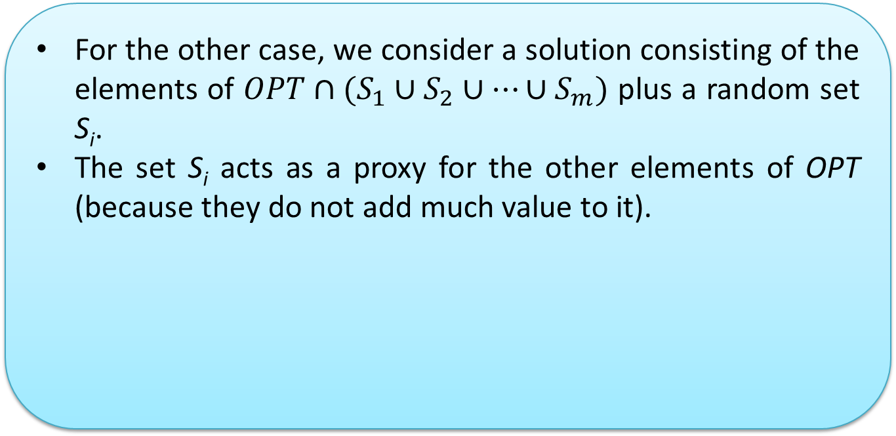
Improving to 1/2-Approximation
To get 1/2-approximation we set c = 2, so that the first part (some set reaches size k) works.
For the other case, we consider a solution consisting of the elements of $OPT∩(S_{1}∪S_{2}∪⋯∪S_{m})$ plus a random set S_{i}.
The set S_{i} acts as a proxy for the other elements of OPT (because they do not add much value to it).
Problem
Can be too large for a valid solution.
Solution
Add a random part of S_{i} of the right size.
Analysis
Based on the above ideas.
A lot of math.

Slide 20
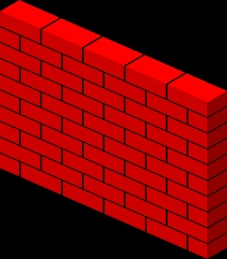
Hardness for General Functions
Ground Set
G
k good elements
B
many bad elements
w
one large element
Objective function f(S)
|S|
without w
k + |S∩G|
with w
Submodular
Non-negative

Slide 21

Hardness for General Functions (cont).
Ground Set
Objective function f(S)
G
k good elements
B
many bad elements
w
one large element
|S|
without w
k + |S∩G|
with w
Optimal Value
The optimal solution is w plus k – 1 elements of G.
Value: 2k - 1
Ratio $∼1/2$
Algorithm’s Value
Assume the elements of G ∪ B arrive in a random order, followed by w.
Algorithm cannot keep in memory more than an insignificant fraction of G elements (in expectation).
Value k + o(1).

Slide 22

Hardness for Monotone Functions – First Attempt
We think here of the function as a coverage function.
  In the formal proof it is a fractional coverage function, which is a bit more general.
So there is an underlying (huge) universe U, and every element v is a subset of U.
U
. . .
o₁
o₂
o₃
o_{k}
v
The optimal solution OPT is a random partition of U.
Let o₁, o₂, …, o_{k} be the elements of OPT.
Assume in this warmup that they all have the same weight.

Slide 23

First Attempt (cont.)
The elements of OPT arrive to the algorithm in the order o₁, o₂,…, o_{k}.
When o_{i} arrives, we accompany it with many decoy elements.
o_{i}
For o₁ the decoy elements are simply random subsets of U of the same size as o₁.
The algorithm cannot tell o₁ apart, and therefore, cannot keep it (with a significant probability).
o₁

Slide 24
First Attempt (cont.)
For larger values of i finding decoy elements is more involved.
  o_{i} does not overlap o₁, o₂, …, o_{i-1} and the decoy elements should mimic that.
Pick the decoy elements as random subsets of
U \ (o₁ ∪ o₂ ∪ ∙∙∙ ∪ o_{i-1}) .
Proves hardness for (simplified) partition matroids.
o₁
o₂
p
1/2-approx
Assume a fraction p of the remaining universe is covered.
o_{i} has the same empty area as any other element.
If only one element is selected:
Area that can no longer be covered = newly covered area.

Slide 25

Closing the Deal
The last proof only works if we allow a single element to be selected from each bunch of elements.
Otherwise, one can select k decoy elements of o₁.
  k random subsets covering 1/k of the universe.
  Cover together 1 – 1/e ≈ 0.632 of the universe.
Selecting elements at later stages is less beneficial since:
  they are chosen from a smaller area, and thus,
  tend to overlap each other more.
We should balance this by choosing elements of later stages as larger subsets.
U
o₁
o₂
o₃
o₄
o₅
How to balance?
We choose subset sizes such that if one picks a single element from each bunch, every element has the same marginal gain.
Does this work?
Selection of one element from each bunch is not always optimal,
but concavity based argument shows that it is close to optimality.
o₁
v
o₆

Slide 26


Related Results
Multiplayer One-Way Communication
The input is split between p players.
Each player gets a message from the previous one, and forwards a message to the next player.
The last player should output the solution.
All our results extend to this model for a large number of players.
2
Two-Players One-Way Communication
The special case of p = 2 players.
1/2-approximation is trivial in this case (output the better among the solutions of the individual players).
For the monotone case we proved that the optimal approximation ratio is 2/3 (non-monotone case was not considered).
Robust Maximization
A variant of the offline problem.
  The algorithm produces a small reservoir of elements.
  The adversary deletes d elements from the reservoir.
  The algorithm then outputs a subset of the reservoir as solution.
The 2/3-approximation for 2-players apply to this setting (but the hardness does not).

Slide 27

Related Open Problems
Maximizing Monotone Functions subject to a Matroid Constraint
The 1/2-hardness of cardinality is the best known.
State-of-the-art 0.3178-approximation algorithm [FLNSZ22].
Maximizing Monotone Functions subject to a Matching Constraint
0.372-hardness (even for bipartite graphs) [FNSZ22].
State-of-the-art 0.171-approximation algorithm [LW21].
Approximability is not settled even in the offline case.
∩
Maximizing Monotone Functions subject to k-Matroids
1/2-approximation in space that is independent of |N|. [FNSZ22]
O(log k / k)-hardness (independent of time complexity) [FNSZ22].
State-of-the-art 1/(4k)-approximation algorithm [CK14].
Even the constant 4 in the last approximation ratio already defies improvement for 8 years.

Slide 28
Questions
?
?
?
?
?

